Slide 1


University of Diyala / College of Eng. Civil Engineering Department.
Class: 1st year / Mathematics I
Homework
𝑞❶/ Evaluate the following limits
(1)
lim
_{𝑡}2
−1
(2)
_{lim} 2𝑥 + 1
2
x→∞ 7 − 𝑡
2
2
_{𝑥}2
x→∞
𝑥 + 3
(3)
lim
−1
1
2
3
2
(4)
1 5𝑡
−5
x→∞ 𝑥 − 5 3 − 𝑥
lim ₂ −
_{𝑥}3
𝑡→∞
3𝑡 𝑡 + 2
_{𝑛}2
(5)
lim
(6)
lim
∞
3
2
x→∞ _{𝑛}
x→∞ 2𝑥 − 100𝑥
3
+ 2𝑛
(7)
_{lim} 3 𝑥³ + 3𝑥
(8)
lim 𝑥 𝑥² − 1 − 𝑥
₋ 1
x→∞
2𝑥³
8 − 𝑠
x→∞
2
(9)
lim
−1
(10)
lim
𝑥 − 4 𝑥 + 1 ²
−4
s→∞ _{𝑠}
2
+ 5
𝑥→∞
𝑥 + 1
2
(11)
lim
2𝑥² − 3
2
(12)
lim 2 −
2𝑥²
₂
0
𝑥→∞ 𝑥 + 3
𝑥→∞
𝑥 + 1
(13)
_{lim} 6𝑥⁶ − 𝑥
6
(14) _{lim}
𝑡 + 2
∞
𝑥→∞
𝑥³ + 1
t→2 𝑡 − 2 ²
⁽¹⁵⁾ lim 𝑥² + 𝑎𝑥 − 𝑥² + 𝑏𝑥
𝑎 − 𝑏
(16)
3
𝜋𝑥³ + 3𝑥
3
𝜋
𝑥→∞
2
lim
3
2
3
𝑥→∞
2 𝑥 + 7𝑥
(17)
_{lim} 𝑥 + sin 𝑥
2
(18)
lim
3𝑥³ − 𝑥²
𝑥→∞
𝑥
𝑥→∞
𝜋𝑥³ − 5𝑥²
𝜋 3
2
(19)
lim 2𝑥² + 3 − 2𝑥² − 5 0
(20)
_{lim} 3 𝑥³ + 3𝑥
x→∞
𝑥→∞
2𝑥³
(21)
lim
³ 1 + 8𝑥²
2
(22)
lim
20𝑥² − 3𝑥
0
5 2
2
3𝑥 − 4𝑥 + 5
𝑥→∞
𝑥 + 4
𝑥→∞
(23)
lim 𝑥² + 2𝑥 − 𝑥² + 3𝑥
(24)
lim
_{3𝑥}7/2 _{+ 7𝑥}−1/2
∞
2 1/2
𝑥→∞
𝑥→∞ 𝑥 − 𝑥

Slide 2
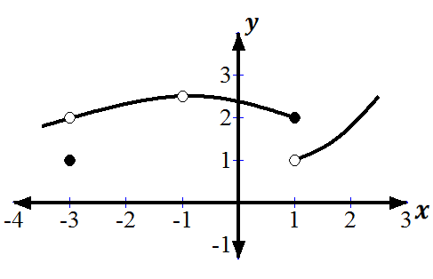
University of Diyala / College of Eng. Civil Engineering Department.
Class: 1st year / Mathematics I
𝑞❷/ if 𝑓 𝑥 = 2 + 5𝑥 − 1 , determine the following:-
a 𝑙𝑖𝑚 𝑓 𝑥
+
Sol. : 2
Sol. ∶ 2
Sol. ∶ 2
1
𝑥→₅
b 𝑙𝑖𝑚₋ 𝑓 𝑥
1
𝑥→₅
c 𝑙𝑖𝑚 𝑓 𝑥
1
𝑥→₅
1
𝑥
_{𝑥}2
𝑥 < 0
𝑞❸/ if 𝑓 𝑥 =
0 ≤ 𝑥 < 1
2
𝑥 = 1
2 − 𝑥
𝑥 > 1
Determine the following:-
𝑎
𝑙𝑖𝑚 𝑓 𝑥
b
𝑙𝑖𝑚 𝑓 𝑥
𝑐
𝑙𝑖𝑚 𝑓 𝑥
+
𝑑
𝑙𝑖𝑚 𝑓 𝑥
−
𝑥→−1
𝑥→1
Sol. 1
𝑥→0
𝑥→0
Sol. − 1
Sol. 0
Sol. − ∞
𝑒
𝑙𝑖𝑚 𝑓 𝑥
𝑓
𝑙𝑖𝑚 𝑓 𝑥 𝑔
+
𝑙𝑖𝑚 𝑓 𝑥
−
𝑕
𝑙𝑖𝑚 𝑓 𝑥
𝑥→0 𝑥→2 𝑥→2
Does not exist Sol.0 Sol.0
𝑥→2
Sol.0
𝑞❹: - Given the function 𝑓 whose graph is below, determine the following:-
lim 𝑓 𝑥
Sol. Sol. Sol. Sol.
Sol. Sol. Sol.
Sol.
2
𝑥→−3
𝑓 −3
𝑓 −1 lim 𝑓 𝑥
N
𝑥→−1
𝑓 1
lim 𝑓 𝑥
N
𝑥→1
lim 𝑓 𝑥
+
𝑥→1
lim 𝑓 𝑥
+
𝑥→1

Slide 3
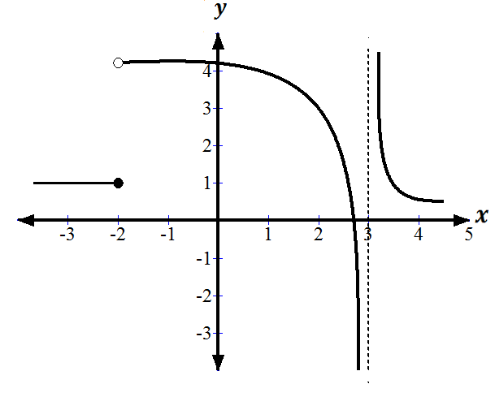
University of Diyala / College of Eng. Civil Engineering Department.
Class: 1st year / Mathematics I
𝑞❺: - Given the function 𝑓 whose graph is below, determine the following:-
a
𝑓 −2 Sol. 1
b 𝑓 3 Sol. un defined c
𝑙𝑖𝑚
−
1
𝑥→−2
Sol.
Sol. Sol. Sol.
Sol. −∞
d
lim
+
4
𝑥→−2
𝑙𝑖𝑚
e
𝑥→−2
Not exist
f
lim
+
+∞
𝑥→3
f
lim
−
𝑥→3
𝑥 − 2
𝑞❻ Show that the limit lim
𝑥→2
𝑥 − 2
If 𝑥 ≤ 1
If 𝑥 > 1
do not exist.
𝑞❼ If 𝑓 𝑥 =
𝑥² + 3
𝑥 + 1
Find a lim f x b lim f x
x→1⁺ x→1⁻
Answer: a 2 b 4
𝑥² + 1
If 𝑥 < −1
If 𝑥 ≥ −1
𝑞❽If 𝑓 𝑥 =
𝑥 + 1
Find a lim 𝑓 𝑥 b lim 𝑓 𝑥 (c) lim 𝑓 𝑥
𝑥→−1⁺ 𝑥→−1⁻
𝑥→−1
Answer: a 0 b 2 c DNE
3
𝑞❾ If f x = −1/2 𝑥²
3
If 𝑥 ≤ −2
If −2 < 𝑥 < 2 If 𝑥 ≥ 2
Find a lim 𝑓 𝑥 (b)
lim 𝑓 𝑥
𝑥→±2⁺
𝑥→±2⁻
𝑥² − 4𝑥 + 5 4 − 𝑥
If If
𝑥 < 2
𝑥 ≥ 2
Answer: a − 2 ,3 b 3, −2
q❿ If 𝑓 𝑥 =
Find a lim 𝑓 𝑥 b lim 𝑓 𝑥 c lim 𝑓 𝑥 (d) 𝑓 2
𝑥→2⁺ 𝑥→2⁻
𝑥→−2
Answer: a 2 b 1 c DNE
(d)2

Slide 4
University of Diyala / College of Eng. Civil Engineering Department.
Class: 1st year / Mathematics I
q➀/ If 𝑓 𝑥 = ^{𝑥 + 2}
If 𝑥 ≤ −1
If 𝑥 > −1
𝑎𝑥²
Find 𝑎 so that lim f x exists
Answer: a = 1
x→−1
2𝑥 + 3
q➁/ If 𝑓 𝑥 = 2
7 − 2𝑥
If 𝑥 < 1
If 𝑥 = 1
If 1 < 𝑥
Find a lim 𝑓 𝑥 b lim 𝑓 𝑥 (c) lim 𝑓 𝑥
𝑥→1
Answer: a 5 b 5 (c) 5
𝑥→1⁺ 𝑥→1⁻
𝑥² − 9
q➂/ If 𝑓 𝑥 = _{9 − 𝑥}²
If 𝑥 ≤ −3
If −3 < 𝑥 < 3 If 3 ≤ 𝑥
𝑥² − 9
Find a lim
𝑓 𝑥 b lim 𝑓 𝑥 (c) lim 𝑓 𝑥
𝑥→−3⁺ 𝑥→−3
𝑥→−3⁻
d lim 𝑓 𝑥 e lim 𝑓 𝑥 (f) lim 𝑓 𝑥
𝑥→ 3⁻ 𝑥→3⁺ 𝑥→3
Answer: a 0 b 0 c 0 d 0 e 0 f 0
𝑞➃/ If 𝑓 𝑥 =
3𝑥 + 2
If 𝑥 < 4
If 𝑥 ≥ 4
5𝑥 + 𝑘
Find 𝑘 so that lim f x exists
Answer: 𝑘 = −6
x→4
If 𝑥 ≤ −1
If 𝑥 > −1
𝑞➄/ If 𝑓 𝑥 = ^{𝑘𝑥 − 3}
𝑥² + 𝑘
Find 𝑘 so that lim f x exists
Answer: a = −2
x→−1
_{𝑥}2
𝑞➅/ If 𝑓 𝑥 = 𝑎𝑥 + ��
2𝑥 − 6
If 𝑥 ≤ −2
If −2 < 𝑥 < 2 If 2 ≤ 𝑥
Find 𝑎 𝑎𝑛𝑑 𝑏 so that lim f x and lim f x are exist
x→−2 x→2
3
Answer: a = − ₂ , b = 1

Slide 5
University of Diyala / College of Eng. Civil Engineering Department.
Class: 1st year / Mathematics I
𝑥 − 4 If −1 < 𝑥 ≤ 2
𝑞➆ 𝑓 𝑥 =
is the function continuous at 𝑥=2 ?
𝑥² − 6 If
2 < 𝑥 < 5
Answer: The function is continuous at 𝑥=2
𝑥³ − 27
If
𝑥 ≠ 3
𝑞➇ /𝑓 𝑥 =
𝑥² − 9
6
is the function continuous at 𝑥 = 3 ?
If 𝑥 = 3
Answer: The function is discontinuous at 𝑥=3
_{𝑥}2
_{a} − a if 0 < x < a
0 if x = a is the function continuous at 𝑥 = a ? _{a}2
a − _{𝑥} if 𝑥 > 𝑎
Answer: The function is continuous at 𝑥=a
𝑞➈/ 𝑓 𝑥 =
𝑞➉/ Find c such that the function
1 − 𝑥
𝑓 𝑥 = 𝑥 − 1
if 0 ≤ x < 1
c
if
𝑥 = 1
is continuous for all 𝑥 ∈ 0,1 ?
𝐴𝑛𝑠𝑤𝑒𝑟: 𝑐 = − ¹
𝑞 / Find a and b such that the function
2𝑥 + 1
𝑓 𝑥 = 𝑎𝑥 + 𝑏
𝑥² + 2
2
21
If 𝑥 ≤ 3
If 3 < 𝑥 < 5 If 5 ≤ 𝑥
is continuous every where ?
𝐴𝑛𝑠𝑤𝑒𝑟: 𝑎 = 10 , 𝑏 = −23
𝑞 /Find a and b such that the function
𝑥 + 1
𝑓 𝑥 = 𝑎𝑥 + 𝑏
3𝑥
22
If 𝑥 < 1
If 1 ≤ 𝑥 ≤ 2 If 𝑥 > 2
is continuous every where ?
𝐴𝑛𝑠𝑤𝑒𝑟: 𝑎 = 4 , 𝑏 = −2

Slide 6
University of Diyala / College of Eng. Civil Engineering Department.
Class: 1st year / Mathematics I
𝑞
23 find the discontinuity of the given functions:-
a
𝑓 𝑥 = 𝑥
𝑥 + 4 If
− 6 ≤ 𝑥 < −2
− 2 ≤ 𝑥 < 2
2 ≤ 𝑥 < 6
𝐴𝑛𝑠𝑤𝑒𝑟: The function is discontinuous 𝑎𝑡 𝑥 = −2 ,2
If 𝑥 < 1
If 1 ≤ 𝑥 ≤ 10 If 𝑥 > 10
Answer: The function is discontinuous 𝑎𝑡 𝑥 = 10
If 0 ≤ 𝑥 < 1
If 1 ≤ 𝑥 < 2
If 2 ≤ 𝑥 < 3
Answer: The function is discontinuous 𝑎𝑡 𝑥 = 2
If
𝑥 − 4 If
_{𝑥}3
b 𝑓 𝑥 = −4 − 𝑥²
6𝑥² + 46
𝑥 + 2 c 𝑓 𝑥 = 𝑥
𝑥 + 5
𝑞 / Find the values of c and d such that the function f is continuous on −3,3
24
𝑥 = −3
If x < 3
𝑥 = 3
𝑐 If
3 𝑓 𝑥 =
9 − 𝑥²
4 − 𝑥² + 7
𝑑 If
Answer: 𝑐 = 8 , 𝑑 = 8

